Slide 1

Innovatronix
Initial Proposal

Slide 2
Contents
Overall strategy
Proposed mechanical design
Sensors used
Actuators used
Algorithms
Task delegation

Slide 3
Overall strategy
Our overall strategy is to use relevant sensors in order to sense the position and state of the robot and control relevant actuators.
Line Detection
Follow line
Sub tasks
Avoid obstacles

Slide 4
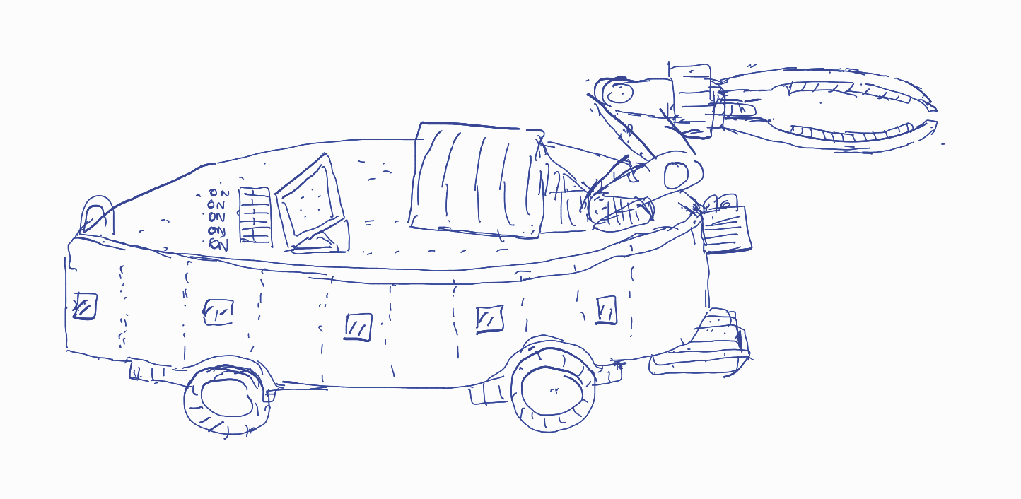
Robot Mechanical Design
Mechanically, we plan on designing an aerodynamic enclosure for increased efficiency.
We plan on conducting simulations to obtain a better drag coefficient.
Arm
Display
Switches for task selection
IR array
ToF sensors

Slide 5
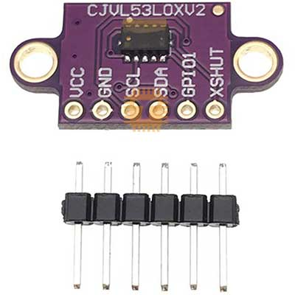
Sensors used
Object Detection: Time of Flight sensor
Increased accuracy even in small ranges over alternatives such as ultrasound sensors and triangulation sensors
Fast measurement time
Compact size
Good performance when the objects aren’t perpendicular to the path of the robot.

Slide 6
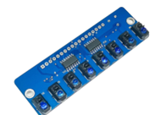
Sensors used
Line Detection: Infrared sensor array
10 IR transmitters and receivers which use the triangulation principle are used here
The black coloured arena would absorb most of the IR light while the white line would reflect most of the light making it possible to detect the line
10 IR sensors are used for increased smoothness of the motion of the robot.

Slide 7
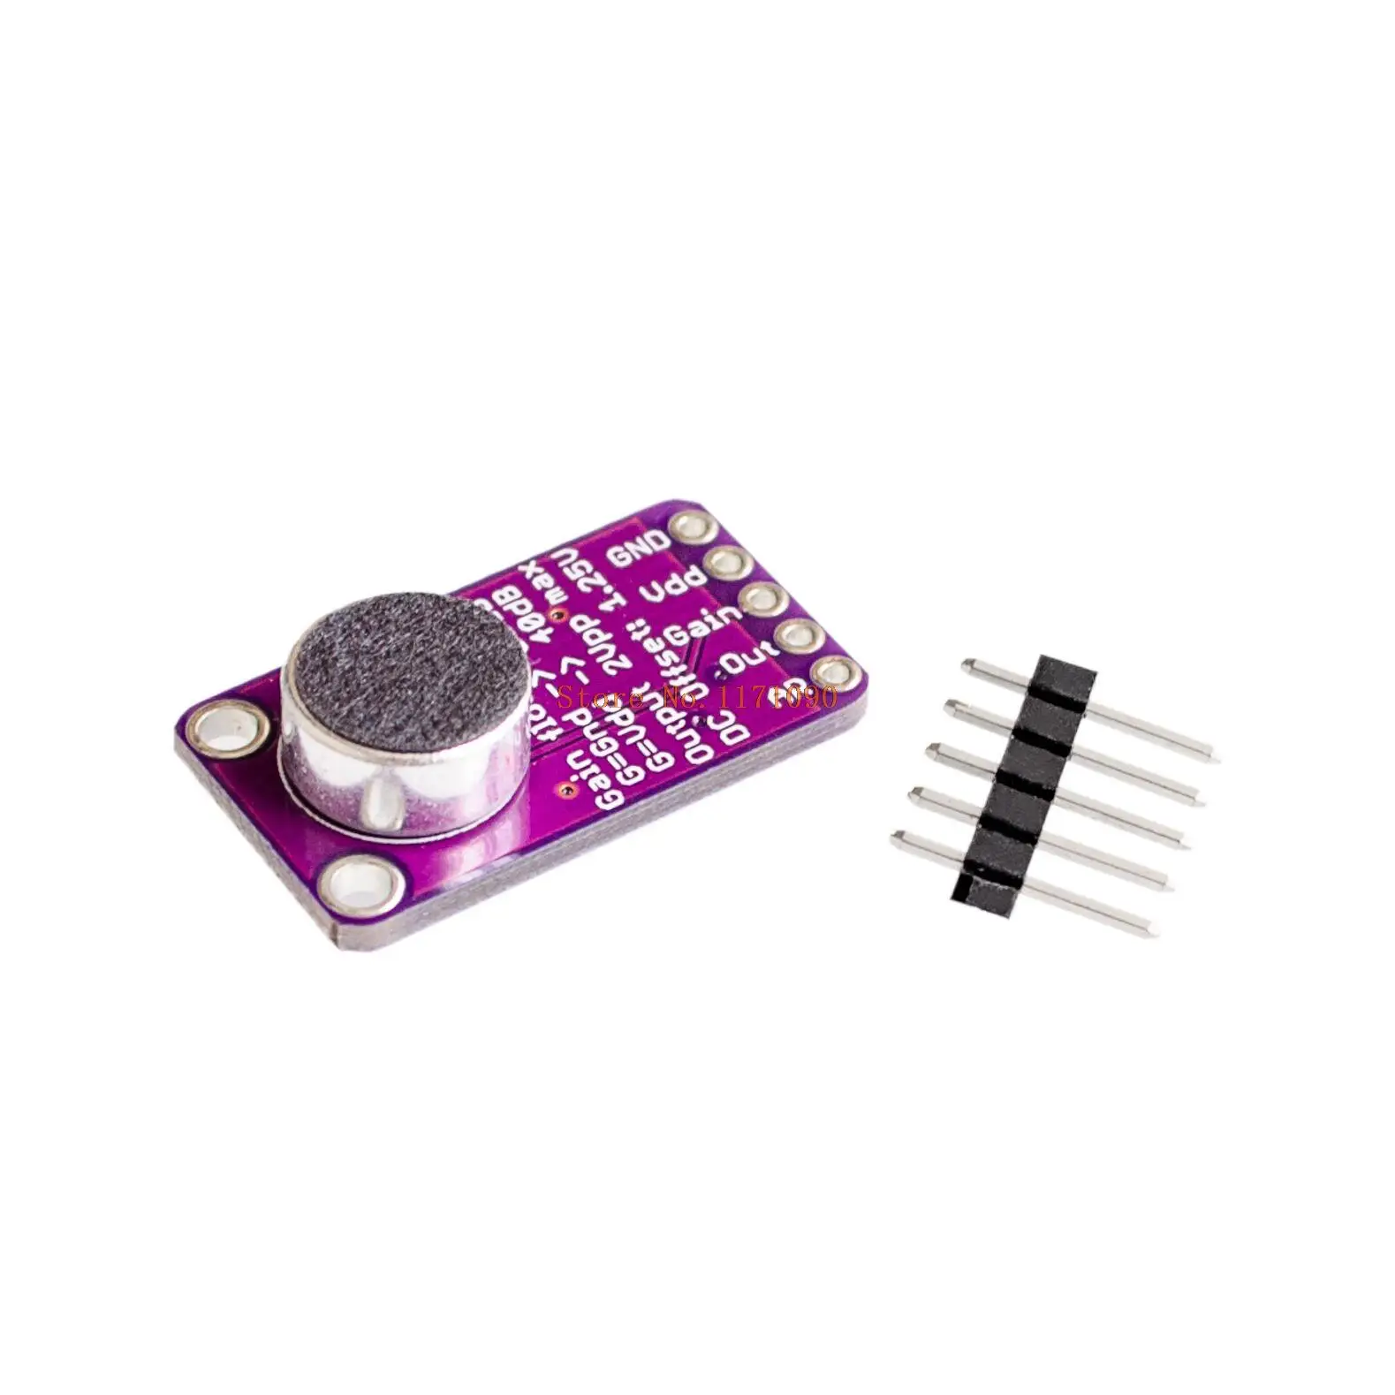
Sensors used
Sound Detection: Microphone
A microphone has been used to detect the intensity of sound.
When the intensity is above a certain level the robot would stop moving.

Slide 8
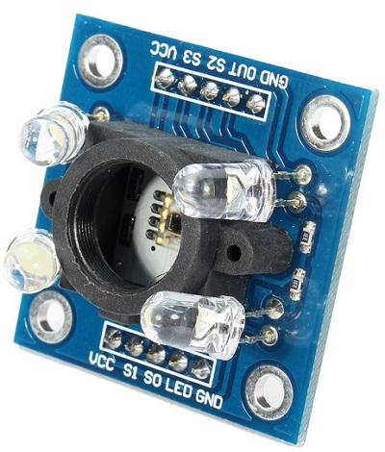
Sensors used
Colour Detection: TCS230 colour detection module
This module consists of photodiodes which are sensitive to red, blue and green light.
Based on the wavelength of light that reaches the sensor, it is possible to detect the colour of the box and the line.
Two sensors are used: one for the detection of the colour of the box and another for the detection of the colour of the line in subtask 4

Slide 9
Actuators
Our robot consists of the following actuators:
DC motors
Servo motors

Slide 10
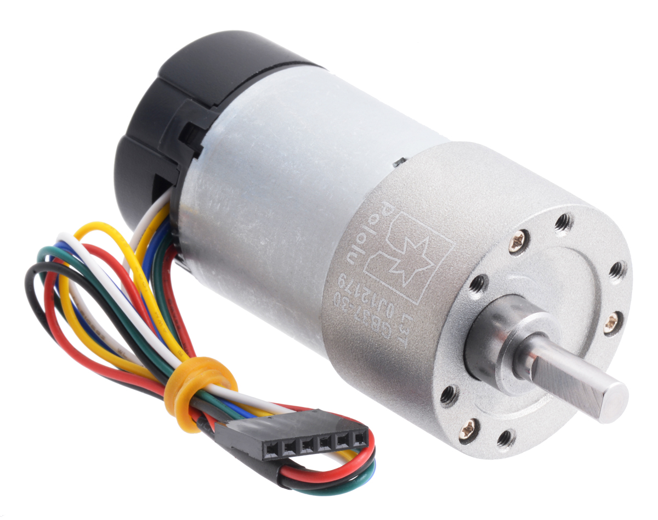
Actuators
Robot movement: DC motors
We propose to use 4 DC motors for each 4 of the robot wheels.
Utilizing 4 motors would provide the necessary torque for quick accelerations.

Slide 11
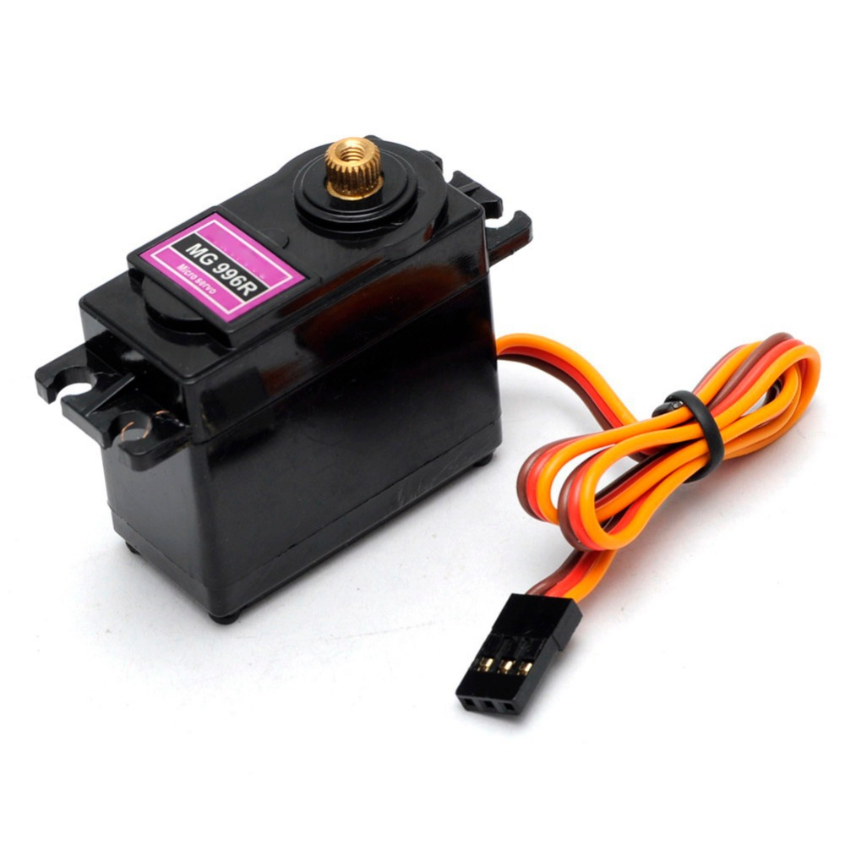
Actuators
Arm movement: Servo motor
We propose to use 2 servo motors to control the robot arm.
One motor would close and open up the arm while the other would move the arm up and down.
The arm is required to pick up boxes and to pull the middle part of the ramp.

Slide 12
Algorithms – Line following
Move forward
If left sensor detects line:
Decrease speed of left motors
Else if right sensor detects line:
Decrease speed of right motors
Else steer straight

Slide 13
Algorithms – Object avoidance
Follow line
If object detected on left:
Steer right until suitable distance is maintained
Go straight
Wait until line detected again
If object detected on right:
Steer left until suitable distance is maintained
Go straight
Wait until line detected again

Slide 14
Algorithms – Colour Detection
Follow line
Stop when colour detected:
Read colour
Go right and check colour
If line colour is same as box colour:
Follow line
Else:
Go back and follow other line
If white detected:
Place box

Slide 15
Algorithms – Hook Detection
Follow line
If front ToF reports small distance:
Stop
Grab hook
Move backwards
Go around ramp

Slide 16
Algorithms – Box Detection
Follow line
If front ToF reports small distance:
Stop
Pick up box

Slide 17
Algorithms – Sound detection
Follow line
If sound intensity above set level:
Stop all motors
Else:
Follow line

Slide 18
Algorithms – Guard robot detection
Wait at junction
If right ToF detects before left ToF:
Turn right and go to final destination

Slide 19
Task Delegation
210253N – Jayathilaka C.B.N.L. – Sensor selection and programming
210027C – Alahakoon U.M.Y.B. – Mechanical design
210236P – Jayakumar W.S. – Enclosure and algorithms
210254T – Jayathilaka D.E.U. – Algorithms and PCB design
210272V – Karavita K.V.D.T.N. – Algorithms and mechanical design

Slide 20
Thank you

